Slide 1
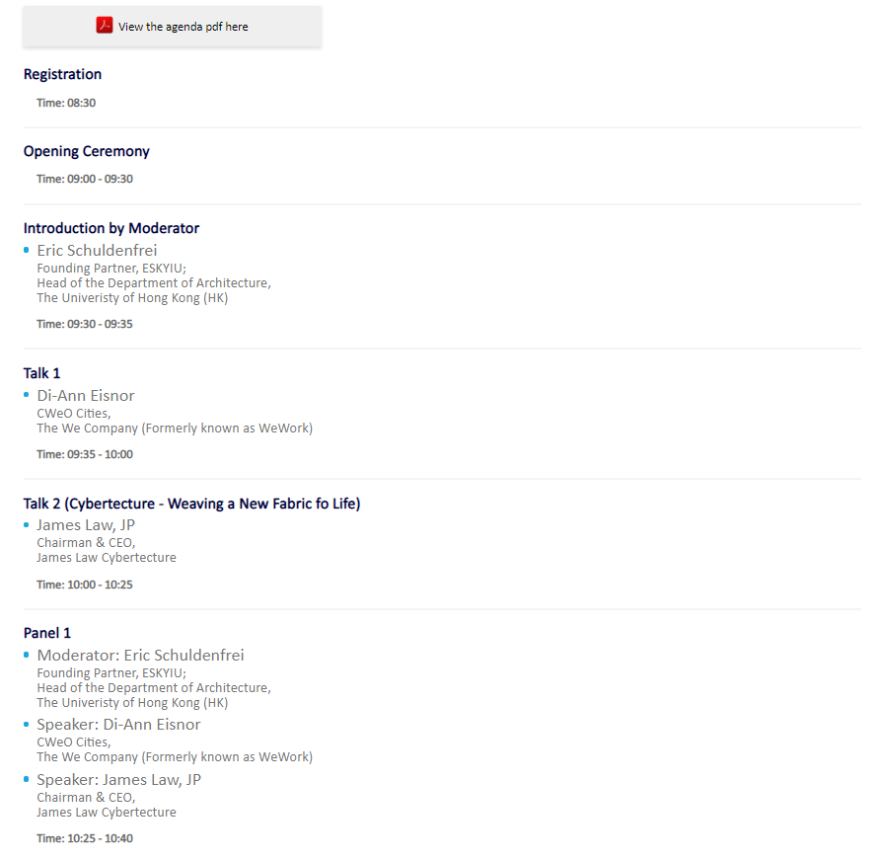
Forum 1 – Agenda page
Founding Partner, ESKYIU;
Head of the Department of Architecture,
The University of Hong Kong
Speaker topic pls display as:
Talk 2: Cybertecture - Weaving a New Fabric of Life
Founding Partner, ESKYIU;
Head of the Department of Architecture,
The University of Hong Kong

Slide 2
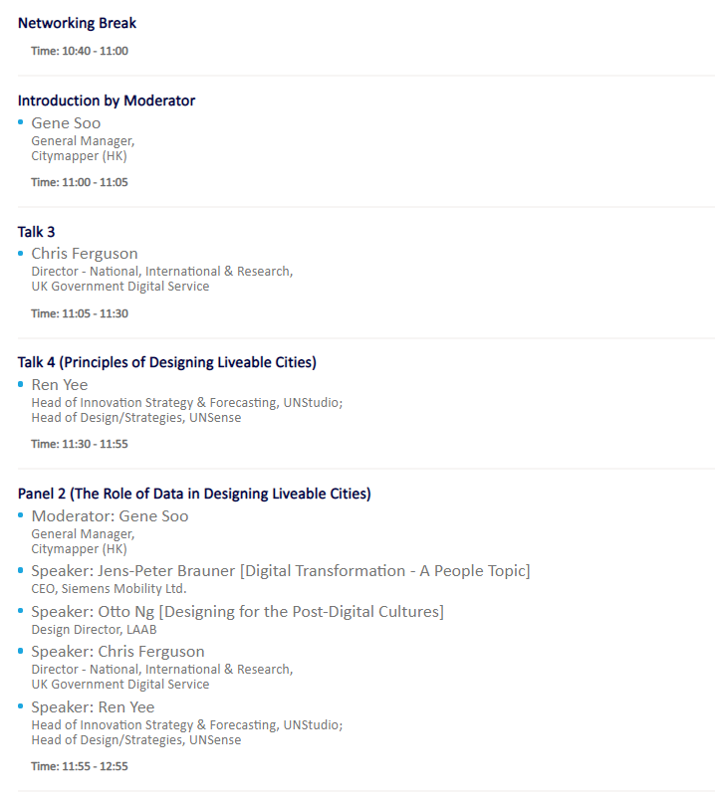
Forum 1 – Agenda page
Speaker topic pls display as:
Talk 4: Principles of Designing Liveable Cities
Head of Innovation Strategy & Forecasting,
UNStudio; Head of Design/Strategies,
UNSense
CEO,
Siemens Mobility Ltd
Design Director,
LAAB
Head of Innovation Strategy & Forecasting,
UNStudio; Head of Design/Strategies,
UNSense

Slide 3
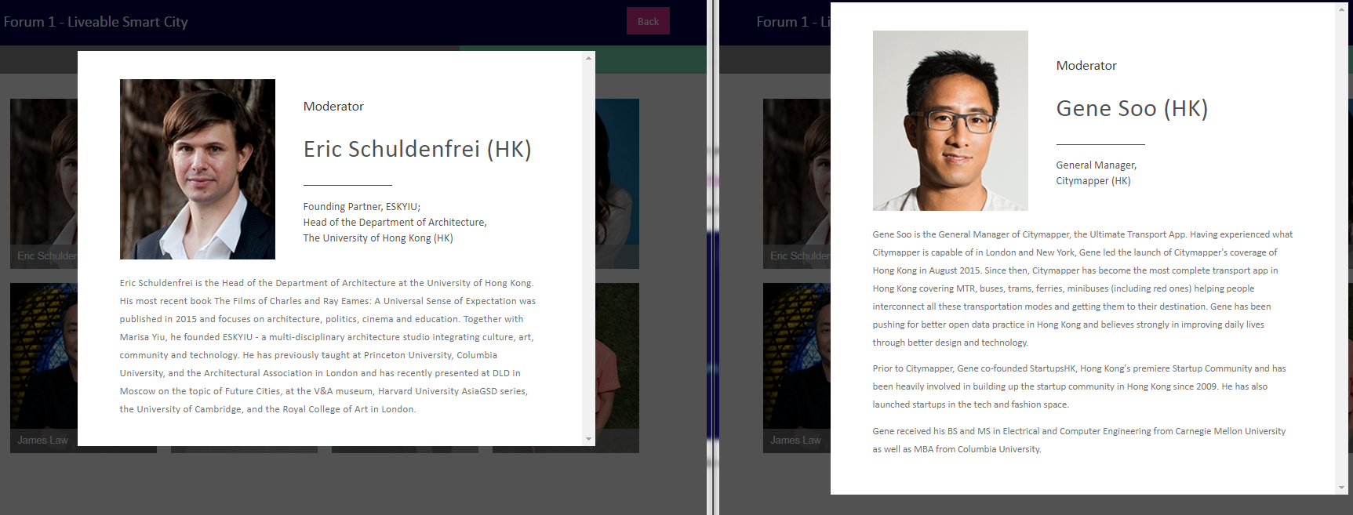
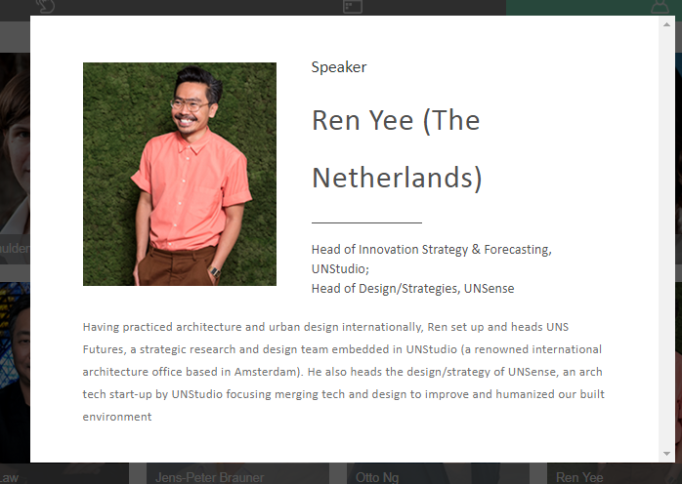
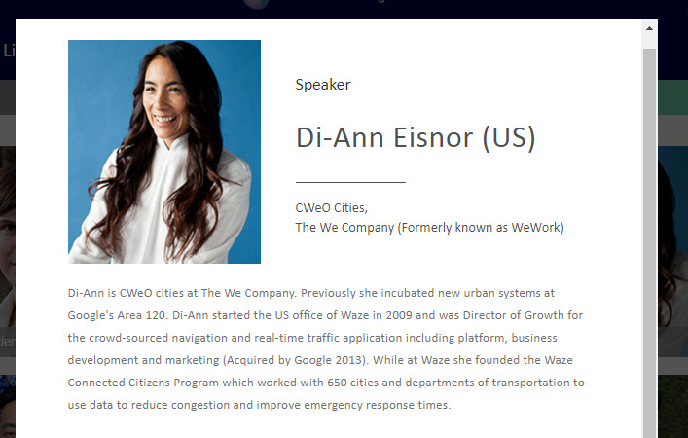
Forum 1 – Bio page
Head of Design/Strategies,
UNSense

Slide 4
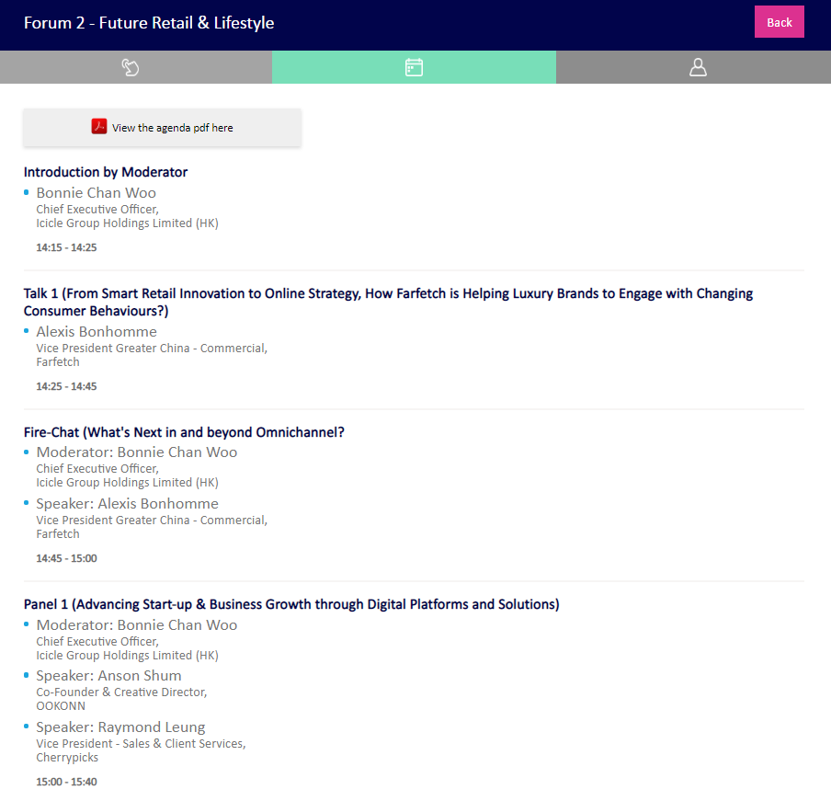
Forum 2 – Agenda page
Time:
Talk 1: From Smart Retail Innovation to Online Strategy: How Farfetch is Helping Luxury Brands to Engage with Changing Consumer Behaviours?
Fire-Chat: What's Next in and beyond Omnichannel?
Panel 1: Advancing ……………. Solutions
Add:
[Two Wings of a Bird]

Slide 5
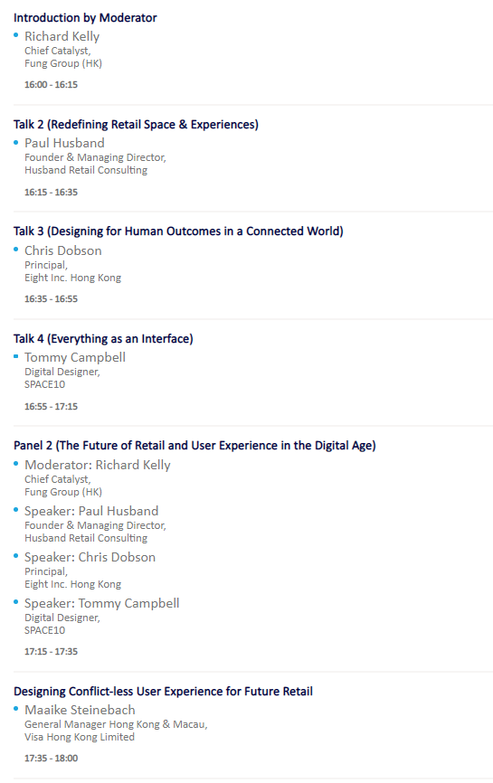
Mikkel Hansen
Program and Partnership Lead,
Explorium HK
Forum 2 – Agenda page
Same, pls add back
“Time:”
Talk 2: Re…………….ces
Talk 3: Des…………….orld
Talk 4: Eve…………….ace
Mikkel Hansen
Program and Partnership Lead,
Explorium HK
Remove

Slide 6
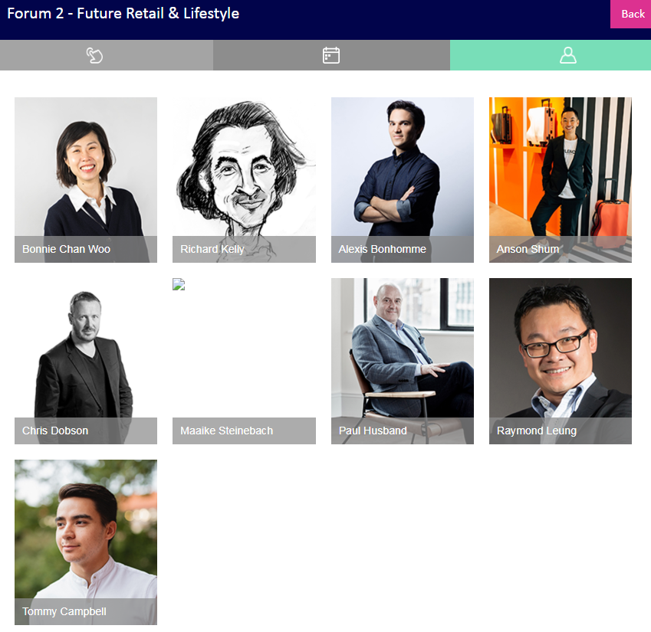
Forum 2 – Bio page
Repalce by Mikkel Hansen
Remove

Slide 7
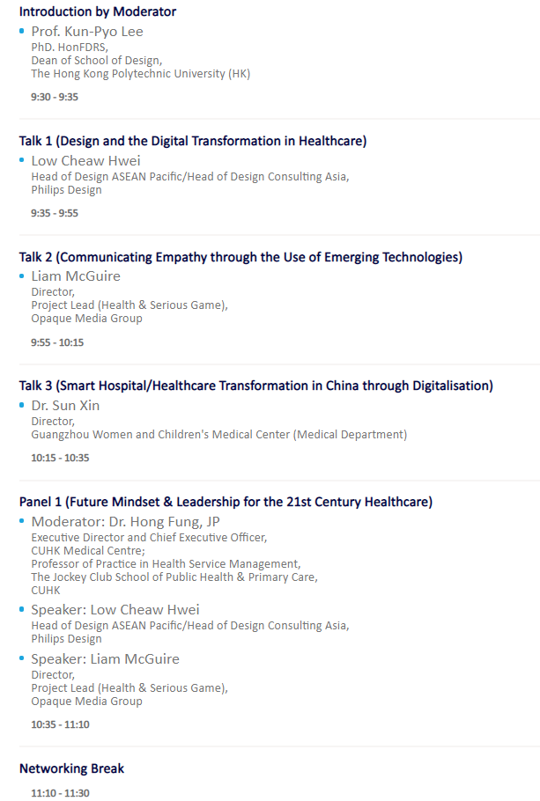
Prof. Kun-Pyo Lee, PhD. HonFDRS
Dean of School of Design,
The Hong Kong Polytechnic University
Forum 3 – Agenda page
Same, pls add back
“Time:”
Talk 1: ……care
Talk 2: Virtual Empathy: Virtual Training for Engendering Empathy
Liam McGuire
Director, Project Lead (Health & Serious Game),
Opaque Media Group
Talk 3: Smart………
Panel 1: ….. …. 21^{st …..}
Liam McGuire
Director, Project Lead (Health & Serious Game),
Opaque Media Group
Time: 11:10 – 11:25

Slide 8
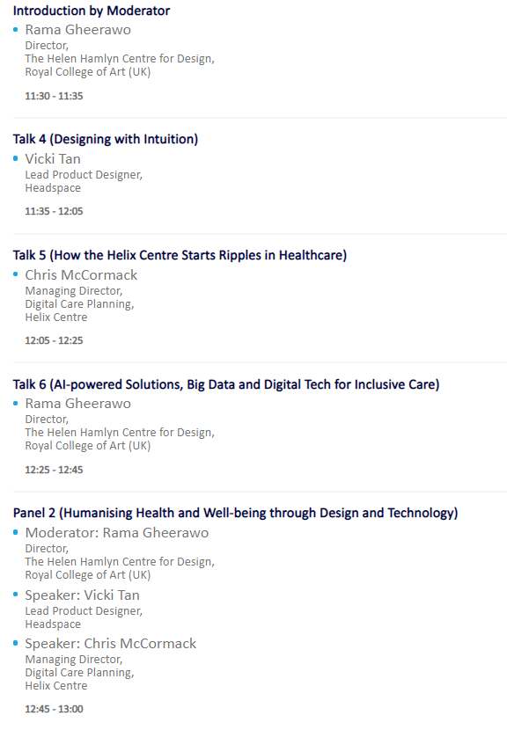
Forum 3 – Agenda page
Same, pls add back
“Time:”
Rama Gheerawo Director,
The Helen Hamlyn Centre for Design, Royal College of Art
Time: 11:25 – 11:30
Talk 4: ……ion
Time: 11:30 – 12:00
Chris McCormack
Managing Director, Digital Care Planning,
Helix Centre
Time: 12:00 – 12:20
Talk 6: Health and Tech: Designing with a Social Attitude
Rama Gheerawo Director,
The Helen Hamlyn Centre for Design, Royal College of Art
Time: 12:20 – 12:40
Panel 2: …...ogy
Same as above
Add Lydia Leung, after Rama & before Vicki
Lydia Leung
CEO
Belun Technology Company Limited
Same as above
Time: 12:40 – 13:00

Slide 9
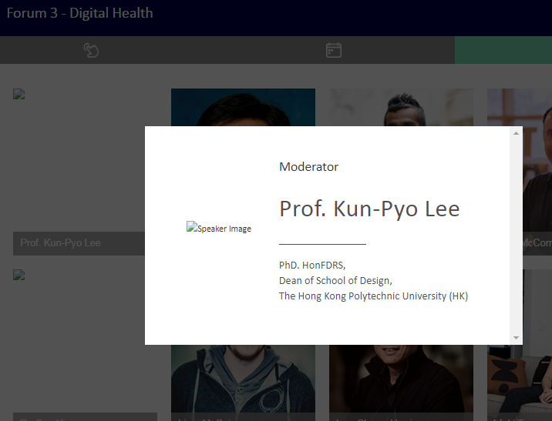
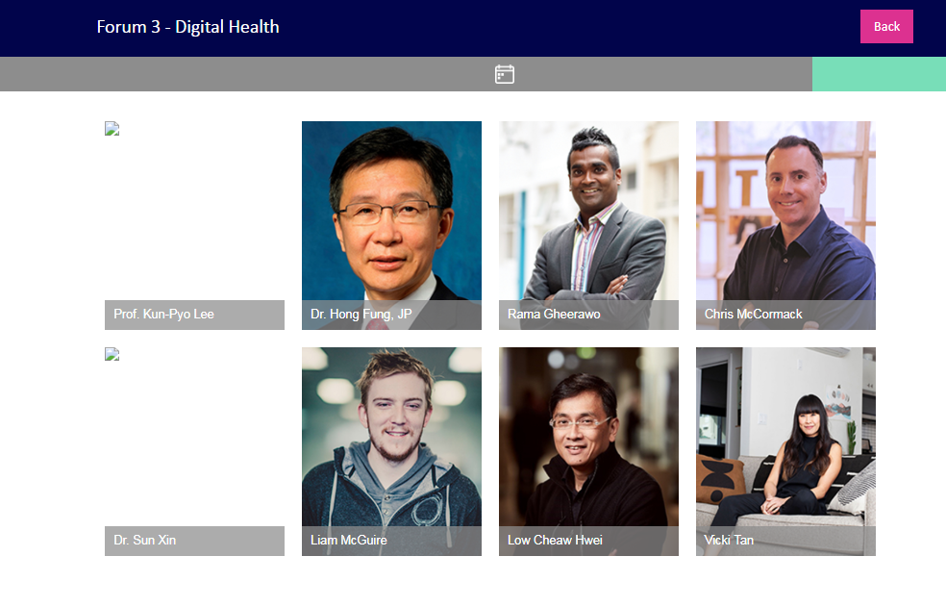
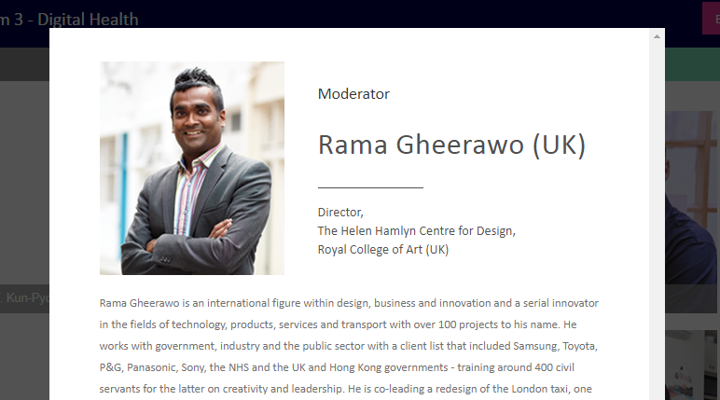
Forum 3 – Bio page
Prof. Kun-Pyo Lee, PhD. HonFDRS
Dean of School of Design,
The Hong Kong Polytechnic University
Add Lydia
Director,
The Helen Hamlyn Centre for Design, Royal College of Art

